Slide 1
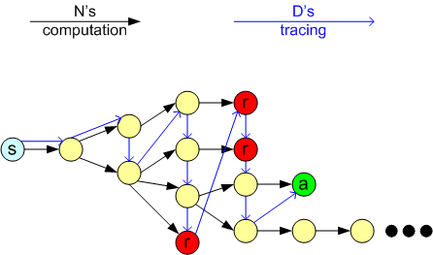

Simulating Nondeterminism

Slide 2
Undecidability
People (like Turing) wondered if all problems were decidable.
The number of possible computer programs is limited by the number of possible contents of memory + a finite number of state transitions. In essence, each program can be mapped to a positive binary integer.
So the number of possible programs is the same as the number of positive integers.
How many possible problems are there that we might want to solve with a computer?

Slide 3
Characteristic Sequence of a Program
You can classify any program by its output on all possible inputs.
Imagine that the program implements a decision problem (returns a Boolean)
Imagine that all inputs are binary integers (which they all are, in some sense)
Here is the list of outputs (0 or 1) for the language of all strings starting with 0 over Σ = {0,1}.:
Here, “e” stands for the empty string, representing a program passed no input.
S* | e | 0 | 1 | 00 | 01 | 10 | 11 | 000 | 001 | Etc
x | 0 | 1 | 0 | 1 | 1 | 0 | 0 | 1 | 1 | Etc

Slide 4
Characteristic Sequences II
Let L be the set of all languages over alphabet Σ.
Let Σ* = {s₁, s₂, s₃, ... }. Note that Σ* is countable – we can talk about the n-th sequence.
For each language A ∈ L, define the characteristic sequence χ_{A} of this language as follows.
The i-th bit of χ_{A} is 1 if s_{i} ∈ A and is 0 if s_{i} ∉ A.
So the characteristic sequence of a Boolean program is a sequence of numbers indicating whether that program returns true or false for the set of all possible inputs expressed as bitstrings.

Slide 5
Characteristic Sequences III
If A = { binary strings s starting with 0 }, then χ_{A} =
So A = { 0, 00, 01, 000, 001, … }
There is no pattern, necessarily, to χ. The set of all characteristic sequences make up binary fractions, which may be non-terminating and non-repeating.
So the number of different characteristic sequences possible are the same as the number of real numbers between 0 and 1.
S* | e | 0 | 1 | 00 | 01 | 10 | 11 | 000 | 001 | Etc
x | 0 | 1 | 0 | 1 | 1 | 0 | 0 | 1 | 1 | Etc

Slide 6
Sizes of Sets
What does it mean to say that two sets of numbers are the same size?
For finite sets, it means they have the same number of elements.
We could find this out either by counting them and coming up with the same number, or by pairing up one element of one set with an element of the other set; then the sets are the same size if there are no leftovers after pairing.
What about infinite sets? For two infinite sets, we clearly can’t count them, but we could try to use the pairing method.

Slide 7
Sizes of Sets
Definition: Two sets (finite or infinite) are the same size if we can put their members into a 1-1 correspondence. That is, if we can map each member of set A with one member of set B in a systematic way.
That is, we can try to “index” their members relative to the natural numbers (the positive integers). So the set of negative integers is the same size as the set of positive integers because I can create the following mapping:
1 | 2 | 3 | 4 | 5 | 6 | 7 | 8 | 9 | …
-1 | -2 | -3 | -4 | -5 | -6 | -7 | -8 | -9 | …

Slide 8
Countable Sets
Definition: A set A is countable if it is finite, or if it has the same size as N, the set of natural numbers (a.k.a., positive integers).
Question: Can we index every set?
Subquestion: Can we index a set X if N ⊂ X? Sometimes.
For instance, consider the set Z of all integers. Here is a mapping between N and Z:
N | 1 | 2 | 3 | 4 | 5 | 6 | 7 | 8 | 9 | …
Z | 0 | 1 | -1 | 2 | -2 | 3 | -3 | 4 | -4 | …

Slide 9
Rational Numbers
Now consider the set of rational numbers, that is numbers which can be expressed as the ratio of two integers (1/4, 77/238, etc).
Is there a mapping between integers and rational numbers?

Slide 10
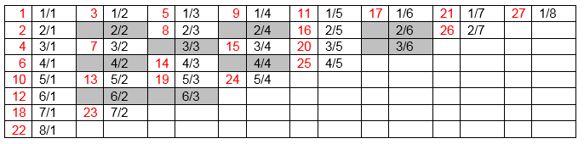
Diagonalization
Here’s one. The red numbers are the index and the shaded black numbers are duplicates of previously indexed numbers (e.g., 1/1 = 2/2 = 3/3, etc.)

Slide 11
Theorem
The set of real numbers between 0 and 1, call it |χ|, is not countable (larger than the number of integers)
This will imply that the entire set of real numbers is uncountable, too.
Proof is by contradiction.
Suppose that |χ| is countable. In fact, suppose that there is a specific mapping between N and |χ|. (If |χ| is countable, there must be at least one such mapping by our definition of “same size” sets).
We will create a number that is not in that mapping. (But it’s an infinite mapping, so what does that mean? How do we know we just haven’t gotten to the number yet? We shall see.)

Slide 12
Proof (cont.)
In any alleged mapping, here is how to create a real number not in the mapping.
Our new number not in the mapping will be 0.<something>
here’s how to get that <something>:
For the first digit to the right of the “binary” place, pick the opposite of the 1st digit in the first number.
For the second digit to the right of the “binary” place, pick the opposite of the 2nd digit in the second number.
In general, for the k^{th} digit to the right of the “binary” place, pick the opposite of the k^{th} digit in the k^{th} number.

Slide 13
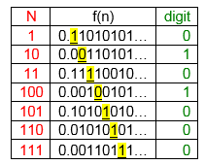
Example construction
Where is this number in the sequence?
It can’t be anywhere, because it differs from every number in the sequence in at least one spot.

Slide 14
So What Does This Mean?
But this is an allegedly complete mapping. And we’ve constructed a number that is not in it. So the mapping can’t be complete. But I could do this for any mapping. So there can’t be a complete mapping!
So there must be numbers in χ that cannot be mapped to positive integers. Thus, by definition, χ is bigger than N. We call χ (and R, the set of real numbers) uncountable.
This shows that there are uncountably many infinite binary sequences. Each corresponds to the output of a possible program.

Slide 15
Programs and Countability
So the number of possible programs is countable.
It’s the same as the number of integers.
Because the number of possible memory configurations is countable (and the program has to be stored in memory).
But the number of characteristic sequences χ is not countable.
It’s the same as the number of real numbers between 0 and 1.
It’s not a repeating or terminating fraction.
In fact, there are more possible problems to solve (characteristic sequences) than there are programs that can be written.

Slide 16
An Undecidable Problem
So there are more possible problems than there are possible programs (even though there are infinitely many of each).
It would sure be nice to see one undecidable problem.
The classic example is the halting problem.

Slide 17
The Halting Problem
Theorem: It is impossible to create a TM H that can tell in a finite time whether or not another TM P halts when presented with input w.
Proof:
Suppose machine H exists. Then H(P,w) returns true if P halts on w, and returns false if P doesn’t halt on w. Notice it does this for all possible programs, without running the program – it is a static analyzer.
Now construct a T.M. C that does the opposite of what H does. This may seem silly, but it’s perfectly legal thing to do. Thus, in Java-like pseudo-code:
boolean C(P,w) {
return !H(P,w);
}

Slide 18
The Halting Problem
One possible string w = ⟨P⟩ itself. That is, we use the specification of the TM as its own input.
Refine C to be a TM D that automatically runs any TM on its own input. That is, D is just TM C, but I am forcing the string w to be the binary representation of P.
boolean D(P) {
return C(P, ⟨P⟩); // = return !H(P, ⟨P⟩);
}
Then:
D(⟨P⟩) accepts ⟨P⟩ if P does not accept ⟨P⟩ (which we know because H(⟨P,⟨P⟩⟩) rejected)
D(⟨P⟩) rejects ⟨P⟩ if P accepts ⟨P⟩ (which we know because H(⟨P,⟨P⟩⟩) accepted)

Slide 19
The Halting Problem
Now run D on itself, that is run D(⟨D⟩). Then:
D(⟨D⟩) accepts ⟨D⟩ if D does not accept ⟨D⟩ (which we know because H(⟨D,⟨D⟩⟩) rejected)
D(⟨D⟩) rejects ⟨D⟩ if D accepts ⟨D⟩ (which we know because H(⟨D,⟨D⟩⟩) accepted)
I got these by just replacing each occurrence of “⟨P⟩ “ by “⟨D⟩ “.

Slide 20
The Halting Problem
Both of these bullet points are completely illogical – So D can’t exist. But the only way D couldn’t exist is if C doesn’t exist. And the only way C can’t exist is if H doesn’t exist. So H doesn’t exist. So the halting problem is undecidable.
The End

